Slide 1
COMP SCI 1103/2103 Algorithm Design & Data Structure Abstract Data Types
School of Computer Science

Slide 2
Data Type
Types are more than just values, they also come with a valid set of operations.
A data type consists of the values AND the set of operations defined over these values.
What can you do with an int x?
x*y x – y x + y x / y
What shouldn’t you do with an int x?
x[y]
Notes:
A data type consists of a collection of values together with a set of basic operations defined on those values

Slide 3
More complex data types
Often we want to store data in a way that isn’t covered by an existing data type.
For example: what if we wanted to represent people waiting in a queue? What fundamental type could we use?
Notes:
Peter Griffin (publicdomainpictures.net) https://www.needpix.com/photo/1319775/people-line-check-in-queue-check-in-free-pictures-free-photos-free-images-royalty-free

Slide 4
Abstract Data Types
Abstract Data Types (ADT) are models with defined behavior given by a set of values and a set of operations.
For our queue, what would be the behavior of each of these operations?
getNext( )
add( )
Are there any other behaviors of a queue?
C++ actually has an implementation of a queue ADT. Let’s have a look…http://www.cplusplus.com/reference/queue/queue/

Slide 5
Not all classes are ADTs
Programmer-defined types are not automatically ADTs.
Implementation must not determine behavior.
User should have no access to the details of implementation
Implementer must be able to change the implementation without impacting the user.
The details have been abstracted away from us.
Unless defined and used with care, the programmer-defined types can make a program difficult to understand and modify. Define the ADT first! Then decide how to implement.
Notes:
Now let’s look into how we can make an ADT from a class.
15min

Slide 6
ADTs for arrays
Think back to using pointers to implement arrays in C/C++
If you could design an Array as an abstract data type, how would you want the Array to behave?
Define some operations you’d want to be able to do with data in an Array
Remember – Don’t worry about HOW you are going to do this, just what do you WANT to be able to do?

Slide 7
C++ Vector and Array data types
C++ provides two array like data types
Let’s look at the details
Vector http://www.cplusplus.com/reference/vector/vector/
Array http://www.cplusplus.com/reference/array/array/
How could you implement a Vector?
How could you implement an Array?
Do you need to know how they are implemented to use them?
What advantage is there to knowing how they are implemented?
[ ] notation available, but also bounds checking on the at() function!
Notes:
Vector uses bounds checking on the at function to stop you making bounds access errors.
You could easily implement a Vector as an array, if you wanted to, as long as you did the checking on the access. Note that Vector allows [] for compatibility and this is just as bad in Vector as it was in array.
Advantage to knowing implementation is you can make some judgement on the efficiency (memory used, etc)

Slide 8
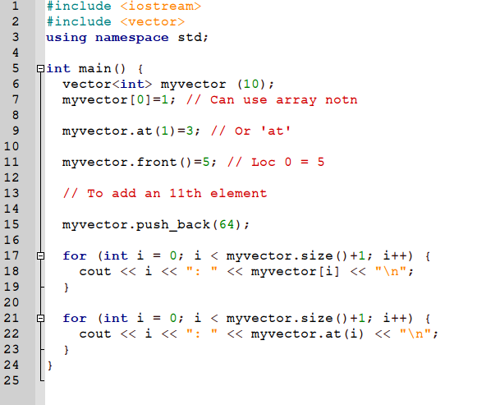
Vector
Notes:
35min

Slide 9
Abstraction and Specification
We aim to separate the specification of how the type is used by the user from the details of how the type is implemented,.
Class abstraction is the separation of class implementation from the use of a class (specification)
The specification should be general enough to include features the user may need
The specification should be restrictive enough to exclude features a user does not need
These are clearly in conflict. Finding the best compromise takes careful thought and practice.

Slide 10
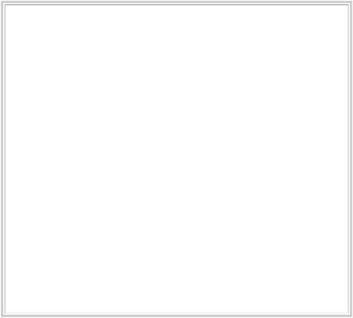
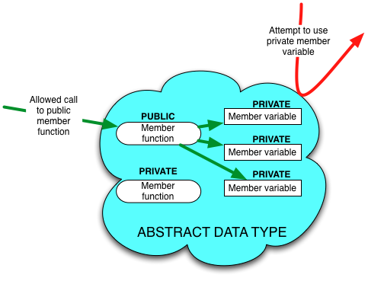
OOP for Abstraction
Designing for Abstraction in OOP:
Make all member variables private
Make the basic operations public and specify how to use them
Make any helping functions private
Notes:
What is abstraction?
You don’t need to know the mother’s name of your bus driver to catch the bus

Slide 11
Interfaces
The set of public member functions in our class, along with a description of what they do, make up the interface of the ADT.
This should be all that someone needs to know to use your ADT.
This is what is visible in the library documentation (vector, array, etc)

Slide 12
Implementation
The implementation of the ADT tells how this interface is realized as C++ code, including:
definitions of public functions
any private or public variables
any private ‘helper’ functions
Notes:
You should not need to know any details about your implementation in order to write the main function

Slide 13
ADTs and Black Boxes
From a design point of view, the implementation of an ADT is like a Black Box - you can’t see inside it.
All a programmer can see is your interface.
A programmer shouldn’t NEED to know about the implementation to make the ADT work.
Do you know how std::string or ‘+’ are implemented?
This is also known as information hiding.

Slide 14
Demo - Example
Let’s model a buffer for storing a video stream
We could use a queue, but what is different about a video stream compared to a queue at a bank, or a queue of processes?
We can model this as a circular queue
We can do this in arrays, without any extra ADTs.
What are the benefits and drawbacks of this approach?
1
2
3
4
5
Notes:
Benefits: No ADT to design and build. Drawbacks: every time we do something with the array, we have to put a check around the access. What happens if we extend the array size or are working with dynamic arrays? More importantly, everyone who works with it has to treat it the same way - there is no abstraction.

Slide 15
The Circular Queue ADT
Let’s design and build a circular queue class together.
Add (adds to end of queue) as we keep inserting elements, we “wrap around” to the beginning of the queue
Remove (removes the next frame in the queue)
If the queue is full we overwrite the oldest value
Allow the user to specify the capacity of the queue
1
2
3
empty
empty
Notes:
Need to have an array inside the ADT that no-one else can access. We need to intercept all calls to the array and map them into the range 0..(n-1). We can use the % in division with remainder operator to achieve this. Why can we use int? Because arrays must be integer multiples. So we need to be able to create an array (arbitrary size or fixed, will we be able to expand it?), put things into (% n), get things out of it (%n). Do we need to provide a size?
Are we providing it as something you add things to, one after the other, or can you put things into an arbitrary location?

Slide 16
Abstract Data Type – Circular Queue
The Abstract Data Type
create
capacity
add
element to insert into queue
remove
removes and returns the oldest element
Mapping ADT to our problem
create
? How many frames
add
? New frame
remove
? Return and remove the oldest frame

Slide 17
Implementation
Now that we’ve defined our circular queue abstract data type, let’s turn to how to build it.
We could use an Array
Would this be more appropriate than a Vector?
Need to keep track of where the front of the queue is
Need to keep track of where the next free space in the queue is
We can use modular arithmetic: no matter how big the number we’re dealing with is, we want the reference to fit into the range 0..(n-1)
The kth element to be added to the queue will be added at Array index k % n

Slide 18
UML class diagram – no longer ADT (why?)
CircularQueue
front : int = 0
currentSize : int = 0
capacity : int
values : vector<string>
+ void add(frame:array<int>)
+ array<int> remove()
Notes:
The private values break the abstraction by revealing how the information will be stored

Slide 19
Implementation
Let’s write the C++ interface and implement the class methods
Demo

Slide 20
Test
How can we test it?
A few things you can think about:
Normal functionality
Boundary value
Special cases
Error handling
Notes:
Remove from empty queue
Add more than maxSize
Add a double
Get element out of bound

Slide 21
Summary
The specification should be general enough to include features the user may need
The specification should be restrictive enough to exclude features a user does not need
Share only information that needs to be shared
In this lecture, we refined our ideas as to what an ADT is and how to make a class an ADT.
This kind of design and implementation activity is crucial in developing good data structures to solve problems.
Use these concepts to define your practical abstract data types for a human player, computer player and referee

Slide 22
Next lecture: what if we want to store something other than strings in our queue?
Notes:
Save as a PowerPoint Show and upload to your MyUni course.
Before you upload the PPS customise slides and indicate where students will find them.

Slide 23
Example
Recall the definition of class in C++
How can we create a Player object?
Do we need to know the implementation of the functions?
Player
move : string
win_count : int
name : string
+ void set_name (string name)
+ void set_move(string move)
+ string get_move()
+ void update_win_count()
+ int get_win_count()
Notes:
We can change the behaviour of the function without letting the users of my class know
20min

